Slide 1
International Cooperation on Border Carbon Adjustment Mechanisms: Time for Action for the WTO
Sustainable Development as Fundamental Pillar of Economic Governance and Public Affairs
Ravenna, 9th November 2023
Alessandro Monti
Assistant Professor, University of Copenhagen
Goran Dominioni
Assistant Professor, Dublin City University

Slide 2
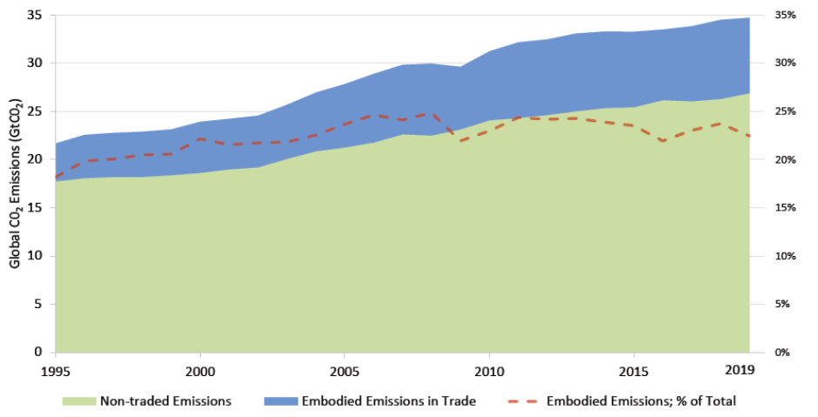
Embedded emissions in international trade
Around 22% of global CO2 emissions are embedded in imported goods – i.e. are debited to the exporting country
Increase of carbon leakage as production continues to shift to countries with lower climate ambition or less-regulated countries
Countries may meet their Paris Agreement targets while emissions abroad increase due to consumption of imported products
Source: Hasanbeigi et al., 2022

Slide 3
Cooperation in the Climate and Trade regimes
Lack of provisions on trade in the Paris Agreement – however openness as general principle under Art 3.5 UNFCCC
Sustainable development as a general principle in the WTO Agreement
Increased focus on climate change in new generation FTAs – e.g. obligation to maintain carbon pricing systems under the EU-UK TCA (Art 392)
Yet, bilateral cooperation has its limits. Still crucial role for multilateral cooperation on climate and trade

Slide 4
Multilateral cooperation on climate and trade
WTO institutions and initiatives
Committee on Trade and Environment (CTE)
Trade and Environmental Sustainability Structured Discussions (TESS-D)
Fossil Fuel Subsidy Reform initiative (FFSR)
Trade day at COP 28
Other multilateral initiatives
Coalition of Trade Ministers on Climate (50+ members)
G7 Climate Club
OECD Inclusive Forum on Carbon Mitigation Approaches (IFCMA)

Slide 5
The case for carbon border adjustment mechanisms
CBAM rationales
By charging a price on GHGs embedded in imported products, CBAMs can level the playing field between domestic and foreign producers selling in the importing country
Incentivize the uptake of more ambitious climate policies in trading partner countries to reduce compliance cost in export sectors – e.g. energy efficiency policies, subsidies for green energy technologies, etc.
CBAMs can reduce leakage by more than one-third on average depending on design of the measure

Slide 6
The challenges of carbon border adjustment mechanisms
CBAMs: WTO law challenges
Compliance issues with WTO law depending on design
Internal regulation (Art III:4 GATT) or tax adjustment (Art III:2 GATT)
Most-favoured-nation and crediting for policies abroad – Article I GATT
Possibility to justify under Article XX GATT?
Unilateralism increasing risk of trade disputes and retaliation

Slide 7
Design of carbon border adjustment mechanisms
Design feature | Suggestion | Rationale(s)
Sectoral coverage | Trade-exposed and carbon-intensive products | Focus on high carbon leakage risk
Emission coverage | Direct emissions – perhaps also GHGs from energy use | Reduces admin costs
Benchmark emissions | Firm-level benchmark per type of product | Maintains incentives to decarbonize Avoids resource shifting
CBDRRC | Using carbon revenues, not exemptions | Avoids trade distortions and slower uptake of greener technologies Helps compliance with WTO law
Policies adjusted and credited | Carbon taxes, emission allowance trading schemes and some implicit carbon prices (expansive list) | Potentially greater environmental effectiveness Compliance with WTO law

Slide 8
EU CBAM and US Foreign Pollution Fee Act
EU CBAM
Crediting only for explicit carbon pricing
Lack of specific provisions on use of revenues – lack of indications that it will support climate mitigation and adaptation in developing countries
U.S. Foreign Pollution Fee Act
Bill proposed in the U.S. Congress in November 2023
Charges based on exporting countries GHG average for each covered product – unless Facility Specific Agreement with Congress approval
Possibility to negotiate International Partnership Agreements with third countries to exclude charges if foreign products have GHG emissions <50% greater than US average and partner also eliminates charges on those goods

Slide 9
Cooperation with other multilateral institutions
OECD, IMF, World Bank — help with estimating carbon pricing equivalent of various GHG policies – e.g. technical work under IFCMA to set methodologies for calculating sector- and product-level carbon intensity metrics
ISO — help set up a certification standard for GHG emissions embedded in producing the goods under the BCA mechanism
UNCTAD — provide a third-party assessment of the economic impacts of border carbon adjustment mechanisms

Slide 10
Benefits of international cooperation
Ensure impartiality of GHG calculation methodologies
Increase compliance of WTO law and reduce risk of disputes
Promote transparency in design and implementation of CBAMs
Achieve greater effectiveness of CBAMs for climate goals

Slide 11
Benefit of multilateral cooperation on CBAM for the WTO
Reaffirm its central role in international trade relations
Incorporate best practices on linking climate and trade considerations from bilateral trade agreements
Pursue its mission on both trade and environment – reduce trade distortions from uninternalized climate externalities while concretizing mutual supportiveness of climate and trade law

Slide 12
Thank you!
Alessandro Monti
Assistant Professor, University of Copenhagen
Goran Dominioni
Assistant Professor, Dublin City University

